Slide 1
Docker Workshop
Simon Idris
January 19, 2018

Slide 2
Introduction to Docker
Hands on Docker workshop

Slide 3
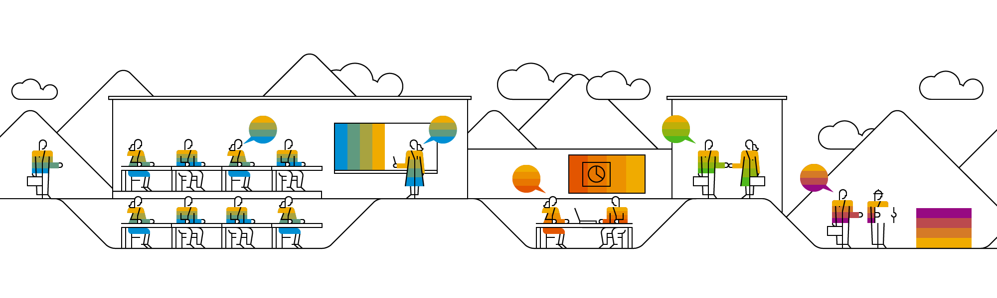
What is Docker?

Slide 4
What is Docker?
Docker is a container platform.
Docker allows users to:
package their software into containers
run and manage containers on almost any machine (Docker host can be installed on Linux, Mac, and Windows 10)

Slide 5
What is a Container?
A container is a standardized unit for development, shipment, and deployment of software.
A container is a runtime instance of an image.
Docker allows users to define, create, and share container images.
A container:
runs natively on the host machine’s kernel (with native access to host resources)
runs as a discrete process, completely isolated from the host environment by default, only accessing host files and ports when it is configured to do so

Slide 6
Containers vs VMs
Virtual Machines
VMs run guest operating systems
Users must directly maintain the Guest OS layer
Applications running in the Guest OS don’t have native access to host resources
Containers
Containers only contain the information needed to run your app
Containers can share a single kernel
Containers run like native processes which can be managed individually using Docker commands

Slide 7
What is a Container Image?
A container image is a lightweight, stand-alone, executable package of a piece of software that includes everything needed to run it: code, runtime, system tools, system libraries, settings.
Container images are defined using a Dockerfile

Slide 8
Example Dockerfile

Slide 9
Docker Engine
The Docker Engine is a client-server application with the following major components:
A server which is a type of long-running program called a daemon process (the dockerd command)
A REST API which specifies interfaces that programs can use to talk to the daemon and instruct it what to do.
A command line interface (CLI) client (the docker command)

Slide 10
Hands-on Workshop

Slide 11
Workshop Resources
Workshop Instructions: https://github.com/sidris-concur/docker/tree/master/workshop

Slide 12
Why should I use Docker?

Slide 13
Benefits of using Docker
Rapid application deployment
containers are lightweight and reusable, allowing them to be deployed quickly
Portability across machines
containers can be run any machine that runs Docker
Version control
you can track successive versions of a container, inspect differences, or roll-back to previous versions
Component reuse
containers reuse components from the preceding layers, which makes them noticeably lightweight

Slide 14
Benefits of using Docker (continued)
Sharing
you can use a remote registries to share your container with others
Lightweight footprint and minimal overhead
Docker images are typically very small, which facilitates rapid delivery and reduces the time to deploy new application containers
Simplified maintenance
Docker reduces effort and risk of problems with application and platform dependencies

Slide 15
Thank you.

